Slide 1

Smart Weather Station
CSE3216
Microcontroller Based System Design Lab
Supervisors,
Mr. Farzad Ahmed
&
Ashna Nawar Ahmed
Presented By
18.02.04.067 - Ashfiqun Mustari
18.02.04.071 – Nosheen Nawar Afnan
18.02.04.079- Tajruba Tahsin Nileema
18.02.04.80 – Rushmia Ahmed

Slide 2

A weather predicting system that can read various weather parameters such as temperature, humidity, pressure, dust density in the air, detect rainfall, and predict storms and tornado.

Slide 3

Objective
Take Accurate
Weather Readings
Provide Accurate
Weather Forecasts
Alarm People during
Natural Disasters
Observe and Analyze
Climate Change
Build a Successful
Weather System
Notes:
Links:
https://pixabay.com/illustrations/cook-boy-cooking-kitchen-chef-1773638/

Slide 4
Social Values
Provide Accurate Weather Forecasts
Accessing Weather Information Anywhere
Helping People to Take Precautionary Measures
Raising Awareness
Notes:
Links:
https://pixabay.com/illustrations/cook-boy-cooking-kitchen-chef-1773638/

Slide 5
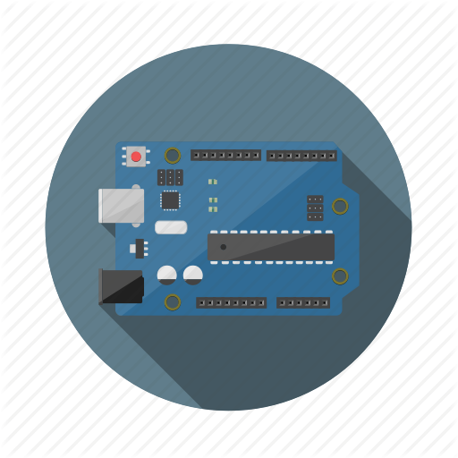





Required Components
Arduino Uno
Breadboard
LCD Display
DHT11
(Temperature and Humidity Sensor)
Grove
(Water Sensor)
Optical Dust Sensor
BMP180
(Pressure Sensor Module)
M-F Jumper Wire
Buzzer
M-M Jumper Wire

Slide 6
Working Procedure
Buzzer Alarming System
Temperature
Rain Fall
Dust Density
Humidity
Atmospheric Pressure
Reading in Digital Data
LCD Display

Slide 7
Block Diagram

Slide 8
Estimated Budget
Equipment | Quantity | Budget (tk)
Arduino Uno | 1 | 670
Breadboard | 1 | 117
DHT22 sensor | 1 | 490
Jumper Wires | many | 200
Grove-(water sensor) | 1 | 71
Optical Dust Sensor | 1 | 605
BMP180 Pressure Sensor Module | 1 | 290
USB Cord | 1 | 150
LCD Display 20x4 | 1 | 525
Buzzer | 1 | 15
The estimated budget is BDT 3133

Slide 9
Actual Cost
Equipment | Quantity | Budget (tk)
Arduino Uno | 1 | 795
Breadboard | 1 | 117
DHT11 sensor | 1 | 165
Jumper Wires | 50 | 125
Grove-(water sensor) | 1 | 225
Optical Dust Sensor GP2Y1010AU0F | 1 | 865
BMP180 Pressure Sensor Module | 1 | 185
LCD Display 16x2 | 1 | 279
Buzzer | 1 | 20
Prototype (PVC Board, glue , etc.) | - | 250
The actual cost is BDT 3016

Slide 10
Budget Comparison
Due to many changes during the project process,
The cost was changed…
Hence the difference between the costs is BDT 117.

Slide 11

Contribution of Team Members

Slide 12

Challenges of the Project
Collecting the proper
components
Connecting the components
properly
Bugs and fixes

Slide 13
Future Scopes
More Parameter
Readings
Real time display
With readings
Storing and Analyzing
The data to observe
long term effects
Deployment in remote
areas

Slide 14
Thank You
Any questions?

